Slide 1
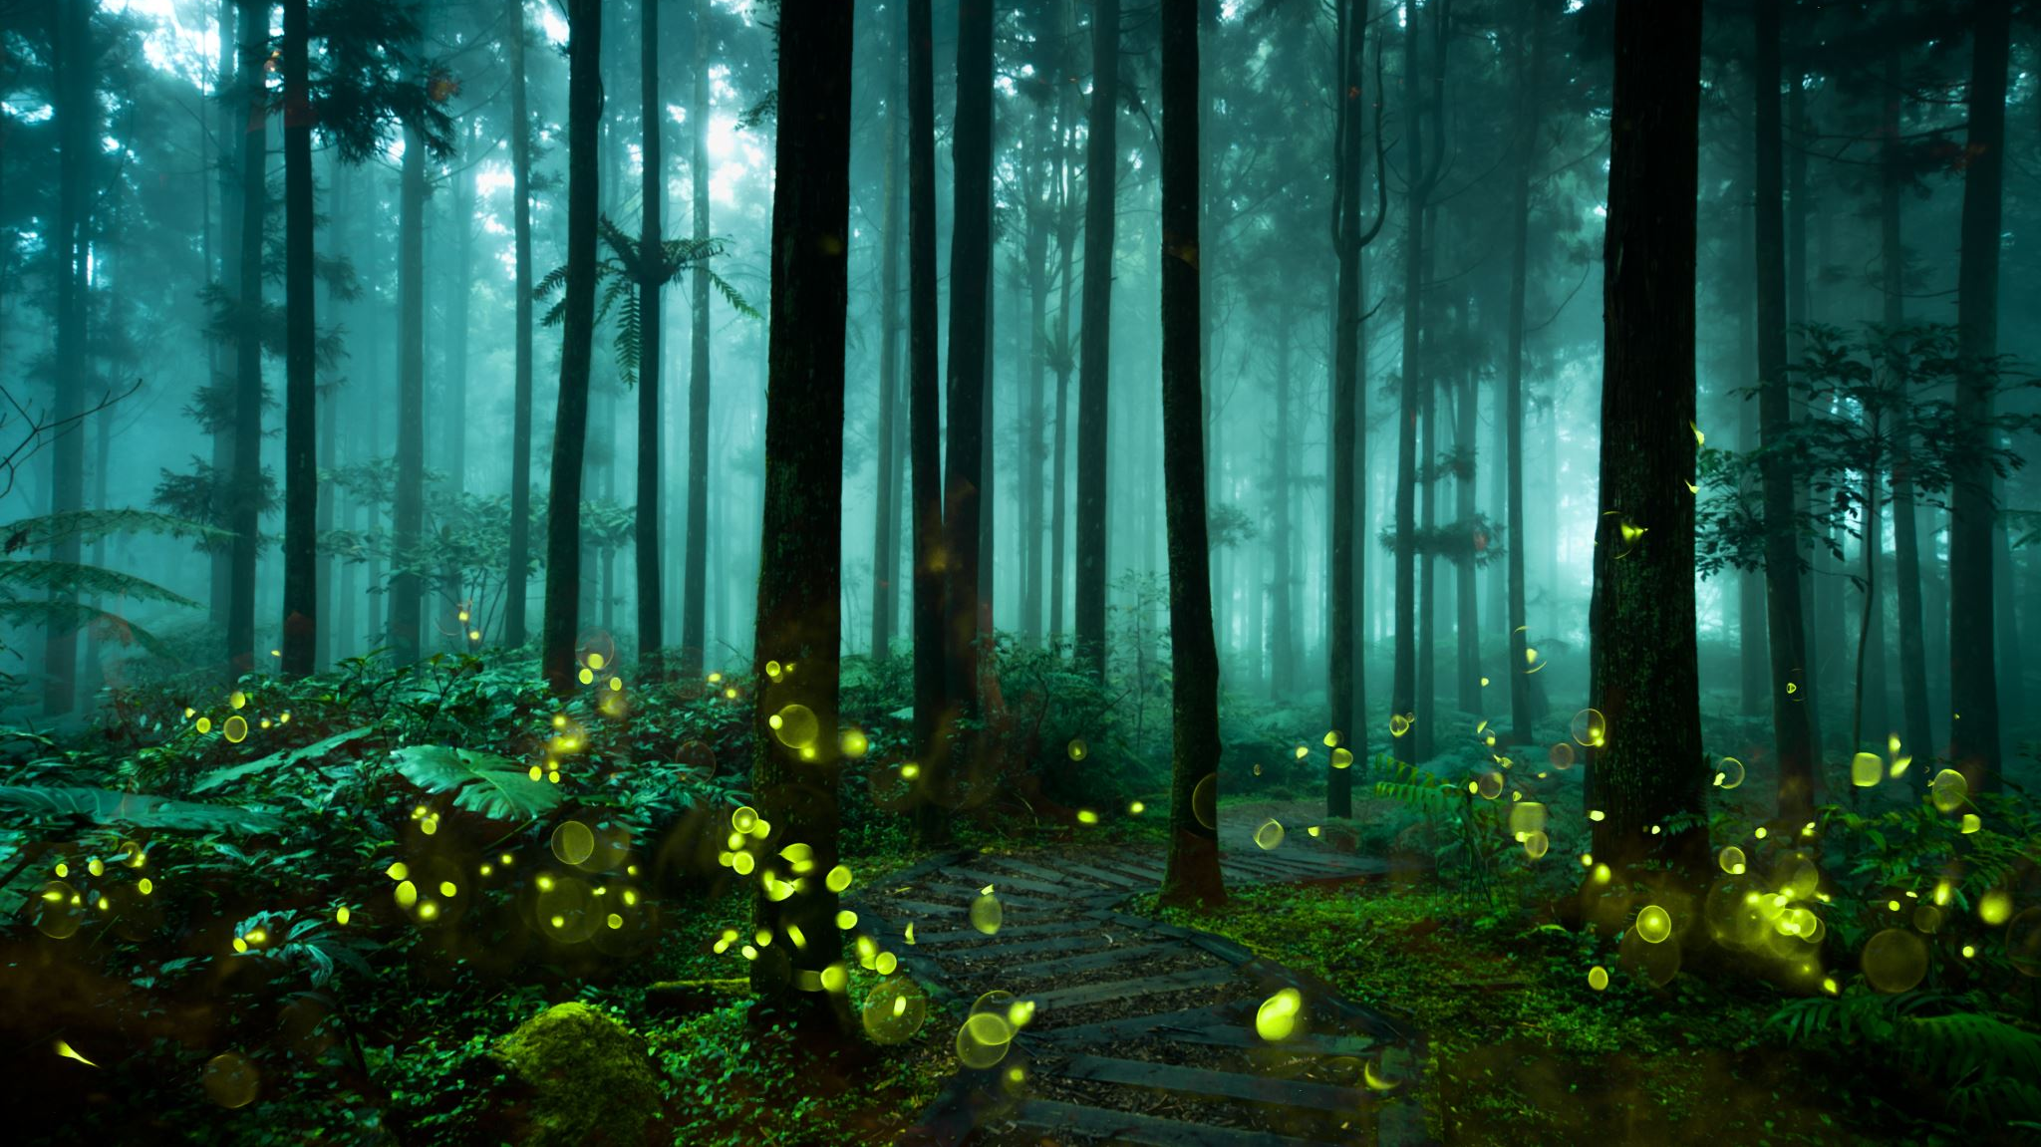
Binary Search Trees
By Alex Joslin

Slide 2
Part 1
Binary TreeS

Slide 3
Terminology
Other Terminology
subtree
ancestors
descendants
siblings
Root
Level 0
E
Branch
Parent
Level 1
C
G
Child
Child
Level 2
A
D
F
I
Leaf
Leaf
Level 3
B
H
J
Leaf
Leaf
Leaf

Slide 4
Examples of Binary Trees
No node can
have more than
2 children.

Slide 5
Not Examples of Binary Trees

Slide 6
Complete Binary Tree
Every node above level n
is completely filled and all
leaf nodes are to the left.
(Used to implement heaps)

Slide 7
Perfect Binary Tree
Every level is completely filled

Slide 8
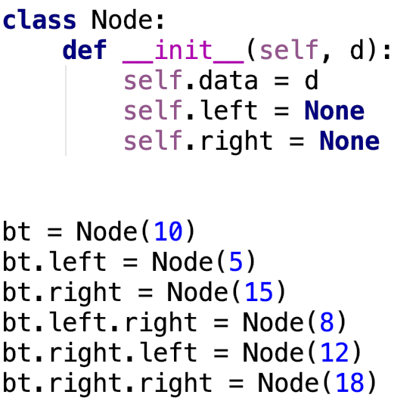
Binary Tree Implementation
10
5
15
8
12
18

Slide 9
Part 2
Binary
Search
Trees

Slide 10
Binary Search Tree
A Binary Search Tree (BST) is a
Binary Tree but implemented in
a useful way.
In BSTs nodes are ordered
in such a way where a
left node’s value is less
than the parent node’s
value and the right node’s
value is more than the
parent nodes value.
50
35
63
12
40
59
70
20
38
45
57
68
72

Slide 11
Part 2.1
Search

Slide 12
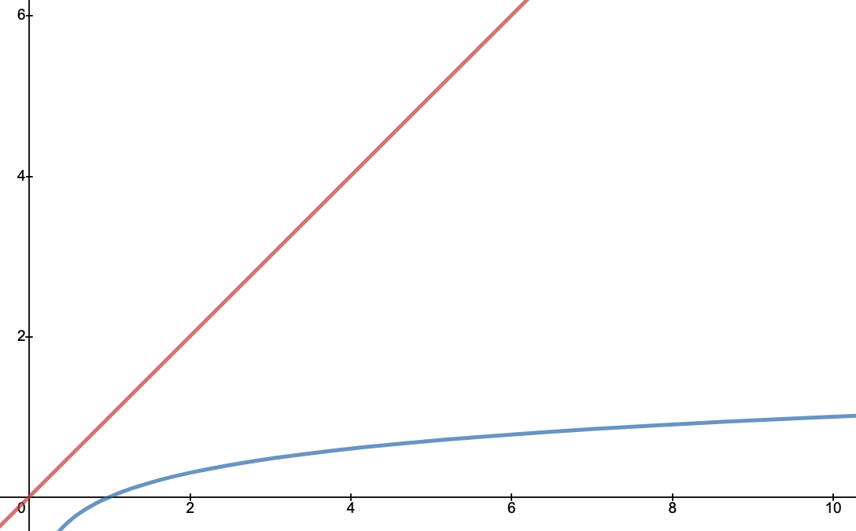
Search
Example: Searching for 15
13
[0, 1, 4, 6, 13, 13, 14, 15, 17, 20]
4
20
O(log(n))
O(n)
1
13
15
0
6
14
17

Slide 13
Part 2.2
Insertion

Slide 14
Insertion
bst = BinarySearchTree()
bst.insert(13)
bst.insert(20)
bst.insert(4)
bst.insert(13)
bst.insert(15)
bst.insert(17)
bst.insert(6)
bst.insert(1)
bst.insert(0)
bst.insert(14)
13
4
20
1
13
15
0
6
14
17

Slide 15
Part 2.3
Traversals

Slide 16
Preorder Traversal
Used to Copy
the tree.
5
Step 1: Visit Root
Step 2: Visit Left
Step 3: Visit Right
3
9
1
4
7
12
2
6
8
11
10
Output: 5, 3, 1, 2, 4, 9, 7, 6, 8, 12, 11, 10

Slide 17
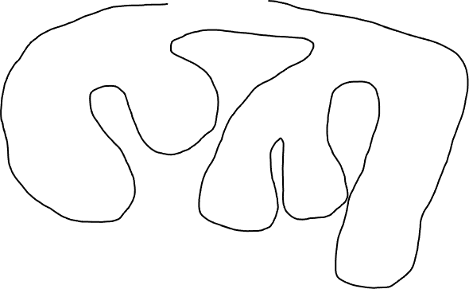
“Walking the tree” Preorder
right
5
3
9
1
4
7
12
2
6
8
11
10
Output: 5, 3, 1, 2, 4, 9, 7, 6, 8, 12, 11, 10

Slide 18
Inorder Traversal
Used to display
tree in order.
5
Step 1: Visit Left
Step 2: Visit Root
Step 3: Visit Right
3
9
1
4
7
12
2
6
8
11
10
Output: 1, 2, 3, 4, 5, 6, 7, 8, 9, 10, 11, 12

Slide 19
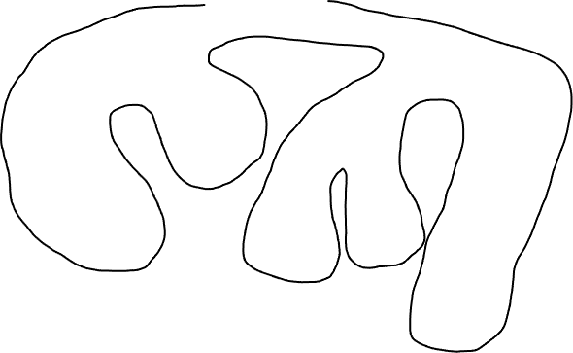
“Walking the tree” Inorder
up
5
3
9
1
4
7
12
2
6
8
11
10
Output: 1, 2, 3, 4, 5, 6, 7, 8, 9, 10, 11, 12

Slide 20
Postorder Traversal
Used to delete
the tree.
5
Step 1: Visit Left
Step 2: Visit Right
Step 3: Visit Root
3
9
1
4
7
12
2
6
8
11
10
Output: 2, 1, 4, 3, 6, 8, 7, 10, 11, 12, 9, 5

Slide 21
“Walking the tree” Postorder
5
Left
3
9
1
4
7
12
2
6
8
11
10
Output: 2, 1, 4, 3, 6, 8, 7, 10, 11, 12, 9, 5

Slide 22
Part 2.4
Deletion

Slide 23
Case1: Delete a Leaf Node
Case2: Delete a Node with 1 Child
Case3: Delete a Node with 2 Children

Slide 24

Case 1: Deleting a Leaf Node
10
bst.delete(8)
5
15
2
8
12
18
3
11
14
16
20
13
17

Slide 25
Case 2: Deleting a Node with Only 1 Child
10
bst.delete(5)
5
15
2
12
18
3
11
14
16
20
13
17

Slide 26
Case 2: Deleting a Node with Only 1 Child
10
bst.delete(5)
bst.delete(14)
2
15
3
12
18
11
14
16
20
13
17

Slide 27
Case 2: Deleting a Node with Only 1 Child
10
bst.delete(5)
bst.delete(14)
2
15
3
12
18
11
13
16
20
17

Slide 28
Case 3: Deleting a Node with 2 Children
10
bst.delete(15)
2
15
replace with node’s
inorder successor
or
postorder successor
12
up
18
3
11
13
16
20
17

Slide 29
Case 3: Deleting a Node with 2 Children
10
bst.delete(15)
2
16
replace with node’s
inorder successor
or
postorder successor
3
12
18
11
13
16
20
17

Slide 30
Case 3: Deleting a Node with 2 Children
10
bst.delete(15)
bst.delete(10)
2
16
up
replace with node’s
inorder successor
or
postorder successor
3
12
18
11
13
17
20

Slide 31
Case 3: Deleting a Node with 2 Children
11
bst.delete(15)
bst.delete(10)
2
16
replace with node’s
inorder successor
or
postorder successor
3
12
18
11
13
17
20

Slide 32
Part 2.5
Implementation

Slide 33
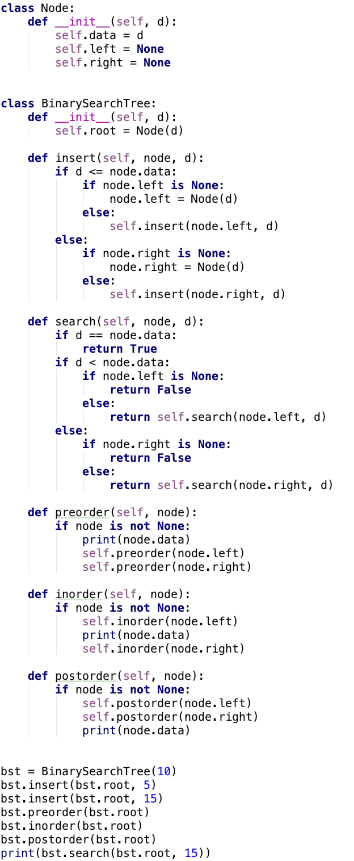
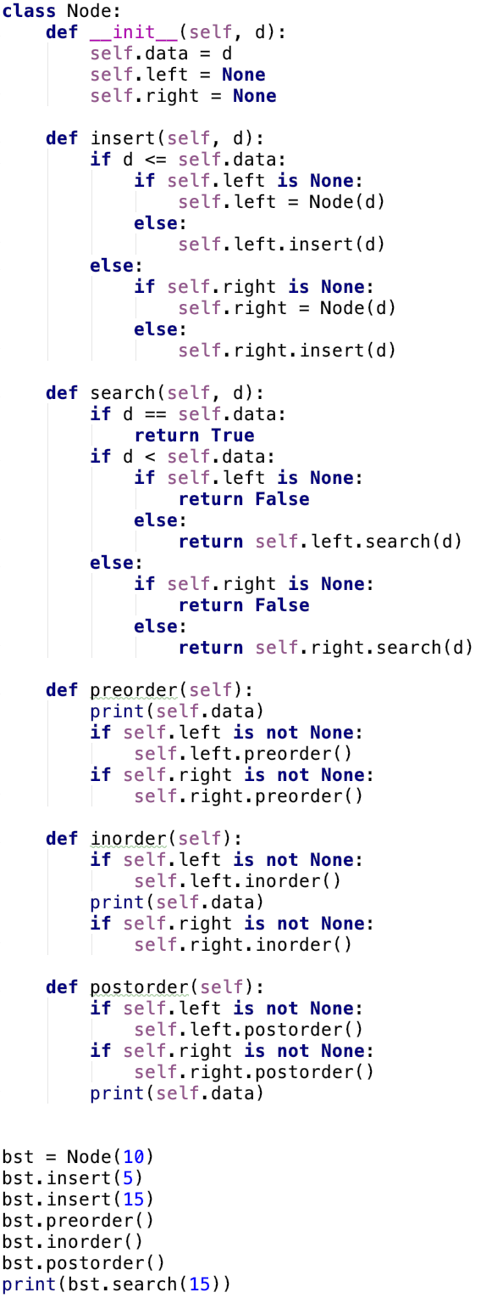
Implementation
10
5
15
PDF

Slide 34
Part 2.5.1
Insert

Slide 35
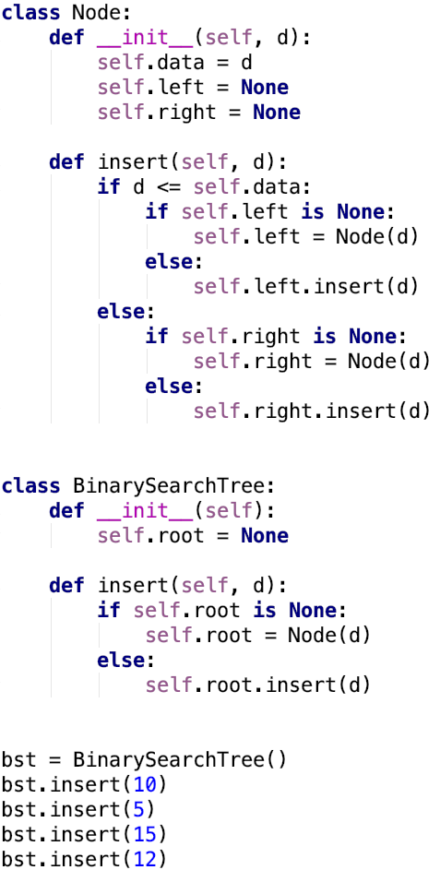

Slide 36
Root
None

Slide 37
Root
None

Slide 38
Root
None

Slide 39
Root
None

Slide 40
Root
10
None
None

Slide 41
Root
10
None
None

Slide 42
Root
10
None
None

Slide 43
Root
10
None
None

Slide 44
Root
10
None
None

Slide 45
Root
10
None
None

Slide 46
Root
10
None
None

Slide 47
Root
10
None
5
None
None

Slide 48
Root
10
None
5
None
None

Slide 49
Root
10
None
5
None
None

Slide 50
Root
10
None
5
None
None

Slide 51
Root
10
None
5
None
None

Slide 52
Root
10
None
5
None
None

Slide 53
Root
10
None
5
None
None

Slide 54
Root
10
5
15
None
None
None
None

Slide 55
Root
10
5
15
None
None
None
None

Slide 56
Root
10
5
15
None
None
None
None

Slide 57
Root
10
5
15
None
None
None
None

Slide 58
Root
10
5
15
None
None
None
None

Slide 59
Root
10
5
15
None
None
None
None

Slide 60
Root
10
5
15
None
None
None
None

Slide 61
Root
10
5
15
None
None
None
None

Slide 62
Root
10
5
15
None
None
None
None

Slide 63
Root
10
5
15
None
None
None
None

Slide 64
Root
10
5
15
None
None
None
12
None
None

Slide 65
Root
10
5
15
None
None
None
12
None
None

Slide 66
Part 2.5.2
Search

Slide 67
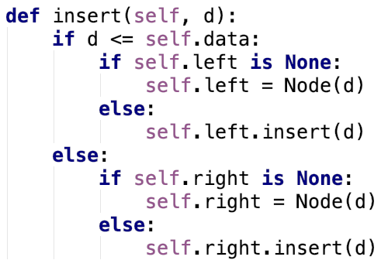
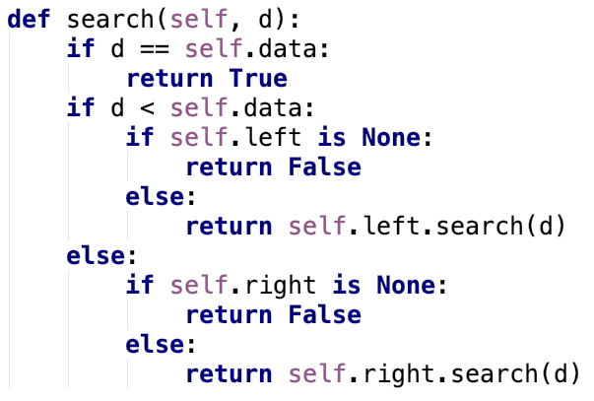

Slide 68
Part 2.5.3
Deletion

Slide 69
Deleting Leaf
&
Deleting Node with 1 Child

Slide 70
Case 1
Case 2
8
8
2
10
2
10
None
4
None
None
None
4
None
None
None
None
None
6
None
None

Slide 71
Case 1
Case 2
8
8
2
10
2
10
None
None
None
None
None
6
None
None
None
None

Slide 72
Case 1
Case 2
8
8
2
10
2
10
None
4
None
None
None
4
None
None
None
None
6
None
None
None

Slide 73
Case 1
Case 2
8
8
2
10
2
10
None
None
None
None
None
6
None
None
None
None

Slide 74
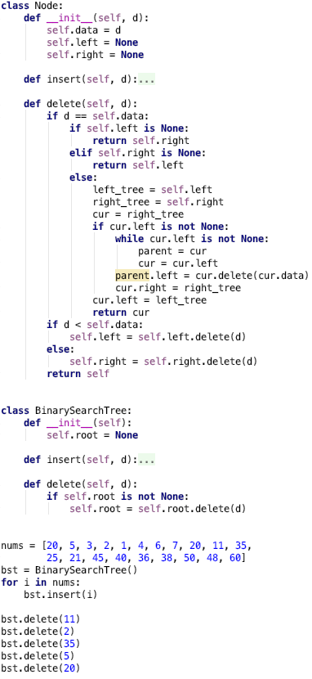
20
5
35
3
6
25
45
None
None
2
4
7
21
40
50
None
None
None
None
None
None
None
1
20
36
48
60
None
None
None
None
None
None
None
None
11
38
None
None
None
None

Slide 75
20
5
35
3
6
25
45
None
None
2
4
7
21
40
50
None
None
None
None
None
None
None
1
20
36
48
60
None
None
None
None
None
None
None
None
11
38
None
None
None
None

Slide 76
Root
20
5
35
3
6
25
45
None
None
2
4
7
21
40
50
None
None
None
None
None
None
None
1
20
36
48
60
None
None
None
None
None
None
None
None
11
38
None
None
None
None

Slide 77
Root
20
5
35
3
6
25
45
None
None
2
4
7
21
40
50
None
None
None
None
None
None
None
1
20
36
48
60
None
None
None
None
None
None
None
None
11
38
None
None
None
None

Slide 78
Root
20
5
35
3
6
25
45
None
None
2
4
7
21
40
50
None
None
None
None
None
None
None
1
20
36
48
60
None
None
None
None
None
None
None
None
11
38
None
None
None
None

Slide 79
Root
20
5
35
3
6
25
45
None
None
2
4
7
21
40
50
None
None
None
None
None
None
None
1
20
36
48
60
None
None
None
None
None
None
None
None
11
38
None
None
None
None

Slide 80
Root
S.L
20
5
35
3
6
25
45
None
None
2
4
7
21
40
50
None
None
None
None
None
None
None
1
20
36
48
60
None
None
None
None
None
None
None
None
11
38
None
None
None
None

Slide 81
Root
S.L
20
5
35
3
6
25
45
None
None
2
4
7
21
40
50
None
None
None
None
None
None
None
1
20
36
48
60
None
None
None
None
None
None
None
None
11
38
None
None
None
None

Slide 82
Root
S.L
20
5
35
3
6
25
45
None
None
2
4
7
21
40
50
None
None
None
None
None
None
None
1
20
36
48
60
None
None
None
None
None
None
None
None
11
38
None
None
None
None

Slide 83
Root
S.L
20
5
35
3
6
25
45
None
None
2
4
7
21
40
50
None
None
None
None
None
None
None
1
20
36
48
60
None
None
None
None
None
None
None
None
11
38
None
None
None
None

Slide 84
Root
S.L
20
5
S.R
35
3
6
25
45
None
None
2
4
7
21
40
50
None
None
None
None
None
None
None
1
20
36
48
60
None
None
None
None
None
None
None
None
11
38
None
None
None
None

Slide 85
Root
S.L
20
5
S.R
35
3
6
25
45
None
None
2
4
7
21
40
50
None
None
None
None
None
None
None
1
20
36
48
60
None
None
None
None
None
None
None
None
11
38
None
None
None
None

Slide 86
Root
S.L
20
5
S.R
35
3
6
25
45
None
None
2
4
7
21
40
50
None
None
None
None
None
None
None
1
20
36
48
60
None
None
None
None
None
None
None
None
11
38
None
None
None
None

Slide 87
Root
S.L
20
5
S.R
35
3
6
25
45
None
None
2
4
7
21
40
50
None
None
None
None
None
None
None
1
20
36
48
60
None
None
None
None
None
None
None
None
11
38
None
None
None
None

Slide 88
Root
S.L
20
5
S.R
35
3
6
S.R
25
45
None
None
2
4
7
21
40
50
None
None
None
None
None
None
None
1
20
36
48
60
None
None
None
None
None
None
None
None
11
38
None
None
None
None

Slide 89
Root
S.L
20
5
S.R
35
3
6
S.R
25
45
None
None
2
4
7
21
40
50
None
None
None
None
None
None
None
1
20
36
48
60
None
None
None
None
None
None
None
None
11
38
None
None
None
None

Slide 90
Root
S.L
20
5
S.R
35
3
6
S.R
25
45
None
None
2
4
7
21
40
50
None
None
None
None
None
None
None
1
20
36
48
60
None
None
None
None
None
None
None
None
11
38
None
None
None
None

Slide 91
Root
S.L
20
5
S.R
35
3
6
S.R
25
45
None
None
2
4
7
21
40
50
None
None
None
None
None
None
None
1
20
36
48
60
None
None
None
None
None
None
None
None
11
38
None
None
None
None

Slide 92
Root
S.L
20
5
S.R
35
3
6
S.R
25
45
None
None
2
4
7
21
40
50
S.R
None
None
None
None
None
None
None
1
20
36
48
60
None
None
None
None
None
None
None
None
11
38
None
None
None
None

Slide 93
Root
S.L
20
5
S.R
35
3
6
S.R
25
45
None
None
2
4
7
21
40
50
S.R
None
None
None
None
None
None
None
1
20
36
48
60
None
None
None
None
None
None
None
None
11
38
None
None
None
None

Slide 94
Root
S.L
20
5
S.R
35
3
6
S.R
25
45
None
None
2
4
7
21
40
50
S.R
None
None
None
None
None
None
None
1
20
36
48
60
None
None
None
None
None
None
None
None
11
38
None
None
None
None

Slide 95
Root
S.L
20
5
S.R
35
3
6
S.R
25
45
None
None
2
4
7
21
40
50
S.R
None
None
None
None
None
None
None
1
20
36
48
60
None
None
None
None
None
None
None
None
11
38
None
None
None
None

Slide 96
Root
S.L
20
5
S.R
35
3
6
S.R
25
45
None
None
2
4
7
21
40
50
S.R
None
None
None
None
None
None
None
1
20
36
48
60
S.L
None
None
None
None
None
None
None
None
11
38
None
None
None
None

Slide 97
Root
S.L
20
5
S.R
35
3
6
S.R
25
45
None
None
2
4
7
21
40
50
S.R
None
None
None
None
None
None
None
1
20
36
48
60
S.L
None
None
None
None
None
None
None
None
11
38
None
None
None
None

Slide 98
Root
S.L
20
5
S.R
35
3
6
S.R
25
45
None
None
2
4
7
21
40
50
S.R
None
None
None
None
None
None
None
1
20
36
48
60
S.L
None
None
None
None
None
None
None
None
11
38
None
None
None
None

Slide 99
Root
S.L
20
5
S.R
35
3
6
S.R
25
45
None
None
2
4
7
21
40
50
S.R
None
None
None
None
None
None
None
1
20
36
48
60
S.L
None
None
None
None
None
None
None
None
11
38
None
None
None
None

Slide 100
Root
S.L
20
5
S.R
35
3
6
S.R
25
45
None
None
2
4
7
21
40
50
S.R
None
None
None
None
None
None
None
1
20
36
48
60
S.L
None
None
None
None
None
None
None
None
11
S.R
38
None
None
None
None

Slide 101
Root
S.L
20
5
S.R
35
3
6
S.R
25
45
None
None
2
4
7
21
40
50
S.R
None
None
None
None
None
None
None
1
20
36
48
60
S.L
None
None
None
None
None
None
None
None
11
S.R
38
None
None
None
None

Slide 102
Root
S.L
20
5
S.R
35
3
6
S.R
25
45
None
None
2
4
7
21
40
50
S.R
None
None
None
None
None
None
None
1
20
36
48
60
S.L
None
None
None
None
None
None
None
None
11
S.R
38
None
None
None
None

Slide 103
Root
S.L
20
5
S.R
35
3
6
S.R
25
45
None
None
2
4
7
21
40
50
S.R
None
None
None
None
None
None
None
1
S.L
20
36
48
60
None
None
None
None
None
None
None
None
None
38
None
None

Slide 104
Root
S.L
20
5
S.R
35
3
6
S.R
25
45
None
None
2
4
7
21
40
50
S.R
None
None
None
None
None
None
None
1
S.L
20
36
48
60
None
None
None
None
None
None
None
None
None
38
None
None

Slide 105
20
5
35
3
6
25
45
None
None
2
4
7
21
40
50
None
None
None
None
None
None
None
1
20
36
48
60
None
None
None
None
None
None
None
None
None
38
None
None

Slide 106
20
5
35
3
6
25
45
None
None
2
4
7
21
40
50
None
None
None
None
None
None
None
1
20
36
48
60
None
None
None
None
None
None
None
None
None
38
None
None

Slide 107
Root
20
5
35
3
6
25
45
None
None
2
4
7
21
40
50
None
None
None
None
None
None
None
1
20
36
48
60
None
None
None
None
None
None
None
None
None
38
None
None

Slide 108
Root
20
5
35
3
6
25
45
None
None
2
4
7
21
40
50
None
None
None
None
None
None
None
1
20
36
48
60
None
None
None
None
None
None
None
None
None
38
None
None

Slide 109
Root
20
5
35
3
6
25
45
None
None
2
4
7
21
40
50
None
None
None
None
None
None
None
1
20
36
48
60
None
None
None
None
None
None
None
None
None
38
None
None

Slide 110
Root
20
5
35
3
6
25
45
None
None
2
4
7
21
40
50
None
None
None
None
None
None
None
1
20
36
48
60
None
None
None
None
None
None
None
None
None
38
None
None

Slide 111
Root
S.L
20
5
35
3
6
25
45
None
None
2
4
7
21
40
50
None
None
None
None
None
None
None
1
20
36
48
60
None
None
None
None
None
None
None
None
None
38
None
None

Slide 112
Root
S.L
20
5
35
3
6
25
45
None
None
2
4
7
21
40
50
None
None
None
None
None
None
None
1
20
36
48
60
None
None
None
None
None
None
None
None
None
38
None
None

Slide 113
Root
S.L
20
5
35
3
6
25
45
None
None
2
4
7
21
40
50
None
None
None
None
None
None
None
1
20
36
48
60
None
None
None
None
None
None
None
None
None
38
None
None

Slide 114
Root
S.L
20
5
35
3
6
25
45
None
None
2
4
7
21
40
50
None
None
None
None
None
None
None
1
20
36
48
60
None
None
None
None
None
None
None
None
None
38
None
None

Slide 115
Root
S.L
20
S.L
5
35
3
6
25
45
None
None
2
4
7
21
40
50
None
None
None
None
None
None
None
1
20
36
48
60
None
None
None
None
None
None
None
None
None
38
None
None

Slide 116
Root
S.L
20
S.L
5
35
3
6
25
45
None
None
2
4
7
21
40
50
None
None
None
None
None
None
None
1
20
36
48
60
None
None
None
None
None
None
None
None
None
38
None
None

Slide 117
Root
S.L
20
S.L
5
35
3
6
25
45
None
None
2
4
7
21
40
50
None
None
None
None
None
None
None
1
20
36
48
60
None
None
None
None
None
None
None
None
None
38
None
None

Slide 118
Root
S.L
20
S.L
5
35
3
6
25
45
None
None
2
4
7
21
40
50
None
None
None
None
None
None
None
1
20
36
48
60
None
None
None
None
None
None
None
None
None
38
None
None

Slide 119
Root
S.L
20
S.L
5
35
3
6
25
45
S.L
None
None
2
4
7
21
40
50
None
None
None
None
None
None
None
1
20
36
48
60
None
None
None
None
None
None
None
None
None
38
None
None

Slide 120
Root
S.L
20
S.L
5
35
3
6
25
45
S.L
None
None
2
4
7
21
40
50
None
None
None
None
None
None
None
1
20
36
48
60
None
None
None
None
None
None
None
None
None
38
None
None

Slide 121
Root
S.L
20
S.L
5
35
3
6
25
45
S.L
None
None
2
4
7
21
40
50
None
None
None
None
None
None
None
1
20
36
48
60
None
None
None
None
None
None
None
None
None
38
None
None

Slide 122
Root
S.L
20
S.L
5
35
3
6
25
45
S.L
None
None
2
4
7
21
40
50
None
None
None
None
None
None
None
1
20
36
48
60
None
None
None
None
None
None
None
None
None
38
None
None

Slide 123
Root
S.L
20
S.L
5
35
3
6
25
45
S.L
None
None
2
4
7
21
40
50
None
None
None
None
None
None
None
1
20
36
48
60
None
None
None
None
None
None
None
None
None
38
None
None

Slide 124
Root
S.L
20
S.L
5
35
3
6
25
45
S.L
None
None
2
4
7
21
40
50
None
None
None
None
None
None
None
1
20
36
48
60
None
None
None
None
None
None
None
None
None
38
None
None

Slide 125
Root
S.L
20
S.L
5
35
3
6
25
45
S.L
None
None
2
4
7
21
40
50
None
None
None
None
None
None
None
1
20
36
48
60
None
None
None
None
None
None
None
None
None
38
None
None

Slide 126
Root
S.L
20
S.L
5
35
3
6
25
45
S.L
None
None
2
4
7
21
40
50
None
None
None
None
None
None
None
1
20
36
48
60
None
None
None
None
None
None
None
None
None
38
None
None

Slide 127
Root
S.L
20
S.L
5
35
3
6
25
45
S.L
None
None
1
4
7
21
40
50
None
None
None
None
None
None
None
None
20
36
48
60
None
None
None
None
None
None
None
38
None
None

Slide 128
Deleting Node
With 2 Children

Slide 129
20
5
35
3
6
25
45
None
None
1
4
7
21
40
50
None
None
None
None
None
None
None
None
20
36
48
60
None
None
None
None
None
None
None
38
None
None

Slide 130
20
5
35
3
6
25
45
None
None
1
4
7
21
40
50
None
None
None
None
None
None
None
None
20
36
48
60
None
None
None
None
None
None
None
38
None
None

Slide 131
20
5
35
3
6
25
45
None
None
1
4
7
21
40
50
None
None
None
None
None
None
None
None
20
36
48
60
None
None
None
None
None
None
None
38
None
None

Slide 132
Root
20
5
35
3
6
25
45
None
None
1
4
7
21
40
50
None
None
None
None
None
None
None
None
20
36
48
60
None
None
None
None
None
None
None
38
None
None

Slide 133
Root
20
5
35
3
6
25
45
None
None
1
4
7
21
40
50
None
None
None
None
None
None
None
None
20
36
48
60
None
None
None
None
None
None
None
38
None
None

Slide 134
Root
20
5
35
3
6
25
45
None
None
1
4
7
21
40
50
None
None
None
None
None
None
None
None
20
36
48
60
None
None
None
None
None
None
None
38
None
None

Slide 135
Root
20
5
35
3
6
25
45
None
None
1
4
7
21
40
50
None
None
None
None
None
None
None
None
20
36
48
60
None
None
None
None
None
None
None
38
None
None

Slide 136
Root
20
S.R
5
35
3
6
25
45
None
None
1
4
7
21
40
50
None
None
None
None
None
None
None
None
20
36
48
60
None
None
None
None
None
None
None
38
None
None

Slide 137
Root
20
S.R
5
35
3
6
25
45
None
None
1
4
7
21
40
50
None
None
None
None
None
None
None
None
20
36
48
60
None
None
None
None
None
None
None
38
None
None

Slide 138
Root
20
S.R
5
35
3
6
25
45
None
None
1
4
7
21
40
50
None
None
None
None
None
None
None
None
20
36
48
60
None
None
None
None
None
None
None
38
None
None

Slide 139
Root
20
S.R
5
35
3
6
25
45
None
None
1
4
7
21
40
50
None
None
None
None
None
None
None
None
20
36
48
60
None
None
None
None
None
None
None
38
None
None

Slide 140
Root
20
S.R
5
35
LT
3
6
25
45
None
None
1
4
7
21
40
50
None
None
None
None
None
None
None
None
20
36
48
60
None
None
None
None
None
None
None
38
None
None

Slide 141
Root
20
S.R
5
35
LT
RT
3
6
25
45
None
None
1
4
7
21
40
50
None
None
None
None
None
None
None
None
20
36
48
60
None
None
None
None
None
None
None
38
None
None

Slide 142
Root
20
S.R
5
35
LT
RT
3
6
25
45
C
None
None
1
4
7
21
40
50
None
None
None
None
None
None
None
None
20
36
48
60
None
None
None
None
None
None
None
38
None
None

Slide 143
Root
20
S.R
5
35
LT
RT
3
6
25
45
C
None
None
1
4
7
21
40
50
None
None
None
None
None
None
None
None
20
36
48
60
None
None
None
None
None
None
None
38
None
None

Slide 144
Root
20
S.R
5
35
LT
RT
3
6
25
45
C
None
None
1
4
7
21
40
50
None
None
None
None
None
None
None
None
20
36
48
60
None
None
None
None
None
None
None
38
None
None

Slide 145
Root
20
S.R
5
35
LT
RT
3
6
25
P
45
C
None
None
1
4
7
21
40
50
None
None
None
None
None
None
None
None
20
36
48
60
None
None
None
None
None
None
None
38
None
None

Slide 146
Root
20
S.R
5
35
LT
RT
3
6
25
P
45
None
None
1
4
7
21
C
40
50
None
None
None
None
None
None
None
None
20
36
48
60
None
None
None
None
None
None
None
38
None
None

Slide 147
Root
20
S.R
5
35
LT
RT
3
6
25
45
None
None
P
1
4
7
21
C
40
50
None
None
None
None
None
None
None
None
20
36
48
60
None
None
None
None
None
None
None
38
None
None

Slide 148
Root
20
S.R
5
35
LT
RT
3
6
25
45
None
None
P
1
4
7
21
40
50
None
None
None
None
None
None
None
None
20
C
36
48
60
None
None
None
None
None
None
None
38
None
None

Slide 149
Root
20
S.R
5
35
LT
RT
3
6
25
45
None
None
P
1
4
7
21
P.L
40
50
None
None
None
None
None
None
None
None
20
C
36
48
60
None
None
None
None
None
None
None
38
None
None

Slide 150
Root
20
S.R
5
35
LT
RT
3
6
25
45
None
None
P
1
4
7
21
P.L
40
50
None
None
None
None
None
None
None
None
20
C
36
48
60
None
None
None
None
None
None
None
38
None
None

Slide 151
Root
20
S.R
5
35
LT
RT
3
6
25
45
None
None
P
1
4
7
21
P.L
40
50
None
None
None
None
None
None
None
None
20
C
36
48
60
None
None
None
None
None
None
None
38
None
None

Slide 152
Root
20
S.R
5
35
LT
RT
3
6
25
45
None
None
P
1
4
7
21
P.L
40
50
None
None
None
None
None
None
None
None
20
C
36
48
60
None
None
None
None
None
None
None
38
None
None

Slide 153
Root
20
S.R
5
35
LT
RT
3
6
25
45
None
None
P
1
4
7
21
P.L
40
50
None
None
None
None
None
None
None
None
20
C
36
48
60
None
None
None
None
None
None
None
38
None
None

Slide 154
Root
20
S.R
5
35
LT
RT
3
6
25
45
None
None
P
1
4
7
21
P.L
40
50
None
None
None
None
None
None
None
None
20
C
36
48
60
None
None
None
None
None
None
None
38
None
None

Slide 155
Root
20
S.R
5
35
LT
RT
3
6
25
45
None
None
P
1
4
7
21
P.L
40
50
None
None
None
None
None
None
None
None
20
C
36
38
48
60
None
None
None
None
None
None
None
None
None

Slide 156
Root
20
S.R
5
35
LT
RT
3
6
25
45
None
None
P
1
4
7
21
P.L
40
50
None
None
None
None
None
None
None
None
20
C
36
38
48
60
None
None
None
None
None
None
None
None
None

Slide 157
Root
C
36
20
S.R
None
5
35
LT
RT
3
6
25
45
None
None
P
1
4
7
21
P.L
40
50
None
None
None
None
None
None
None
None
20
38
48
60
None
None
None
None
None
None
None
None

Slide 158
Root
C
36
20
S.R
None
5
35
LT
RT
3
6
25
45
None
None
P
1
4
7
21
P.L
40
50
None
None
None
None
None
None
None
None
20
38
48
60
None
None
None
None
None
None
None
None

Slide 159
Root
C
36
20
S.R
5
35
LT
RT
3
6
25
45
None
None
P
1
4
7
21
P.L
40
50
None
None
None
None
None
None
None
None
20
38
48
60
None
None
None
None
None
None
None
None

Slide 160
Root
C
36
20
S.R
5
35
LT
RT
3
6
25
45
None
None
P
1
4
7
21
P.L
40
50
None
None
None
None
None
None
None
None
20
38
48
60
None
None
None
None
None
None
None
None

Slide 161
Root
C
36
20
S.R
5
35
LT
RT
3
6
25
45
None
None
P
1
4
7
21
P.L
40
50
None
None
None
None
None
None
None
None
20
38
48
60
None
None
None
None
None
None
None
None

Slide 162
Root
C
36
20
S.R
5
35
LT
RT
3
6
25
45
None
None
P
1
4
7
21
P.L
40
50
None
None
None
None
None
None
None
None
20
38
48
60
None
None
None
None
None
None
None
None

Slide 163
Root
20
S.R
5
36
3
6
25
45
None
None
1
4
7
21
40
50
None
None
None
None
None
None
None
None
20
38
48
60
None
None
None
None
None
None
None
None

Slide 164
20
5
36
3
6
25
45
None
None
1
4
7
21
40
50
None
None
None
None
None
None
None
None
20
38
48
60
None
None
None
None
None
None
None
None

Slide 165
20
5
36
3
6
25
45
None
None
1
4
7
21
40
50
None
None
None
None
None
None
None
None
20
38
48
60
None
None
None
None
None
None
None
None

Slide 166
Root
20
5
36
3
6
25
45
None
None
1
4
7
21
40
50
None
None
None
None
None
None
None
None
20
38
48
60
None
None
None
None
None
None
None
None

Slide 167
Root
20
5
36
3
6
25
45
None
None
1
4
7
21
40
50
None
None
None
None
None
None
None
None
20
38
48
60
None
None
None
None
None
None
None
None

Slide 168
Root
20
5
36
3
6
25
45
None
None
1
4
7
21
40
50
None
None
None
None
None
None
None
None
20
38
48
60
None
None
None
None
None
None
None
None

Slide 169
Root
20
5
36
3
6
25
45
None
None
1
4
7
21
40
50
None
None
None
None
None
None
None
None
20
38
48
60
None
None
None
None
None
None
None
None

Slide 170
Root
S.L
20
5
36
3
6
25
45
None
None
1
4
7
21
40
50
None
None
None
None
None
None
None
None
20
38
48
60
None
None
None
None
None
None
None
None

Slide 171
Root
S.L
20
5
36
3
6
25
45
None
None
1
4
7
21
40
50
None
None
None
None
None
None
None
None
20
38
48
60
None
None
None
None
None
None
None
None

Slide 172
Root
S.L
20
5
36
3
6
25
45
None
None
1
4
7
21
40
50
None
None
None
None
None
None
None
None
20
38
48
60
None
None
None
None
None
None
None
None

Slide 173
Root
S.L
20
5
36
3
6
25
45
None
None
1
4
7
21
40
50
None
None
None
None
None
None
None
None
20
38
48
60
None
None
None
None
None
None
None
None

Slide 174
Root
S.L
20
5
36
LT
3
6
25
45
None
None
1
4
7
21
40
50
None
None
None
None
None
None
None
None
20
38
48
60
None
None
None
None
None
None
None
None

Slide 175
Root
S.L
20
5
36
LT
RT
3
6
25
45
None
None
1
4
7
21
40
50
None
None
None
None
None
None
None
None
20
38
48
60
None
None
None
None
None
None
None
None

Slide 176
Root
S.L
20
5
36
LT
RT
3
6
C
25
45
None
None
1
4
7
21
40
50
None
None
None
None
None
None
None
None
20
38
48
60
None
None
None
None
None
None
None
None

Slide 177
Root
S.L
20
5
36
LT
RT
3
6
C
25
45
None
None
1
4
7
21
40
50
None
None
None
None
None
None
None
None
20
38
48
60
None
None
None
None
None
None
None
None

Slide 178
Root
S.L
20
5
36
LT
RT
3
6
C
25
45
None
None
1
4
7
21
40
50
None
None
None
None
None
None
None
None
20
38
48
60
None
None
None
None
None
None
None
None

Slide 179
Root
S.L
20
5
36
LT
RT
3
6
C
25
45
None
1
4
7
21
40
50
None
None
None
None
None
None
None
None
20
38
48
60
None
None
None
None
None
None
None
None

Slide 180
Root
S.L
20
5
36
LT
RT
3
6
C
25
45
None
1
4
7
21
40
50
None
None
None
None
None
None
None
None
20
38
48
60
None
None
None
None
None
None
None
None

Slide 181
Root
S.L
20
5
36
LT
RT
3
6
C
25
45
None
1
4
7
21
40
50
None
None
None
None
None
None
None
None
20
38
48
60
None
None
None
None
None
None
None
None

Slide 182
Root
S.L
20
5
36
LT
RT
3
6
C
25
45
None
1
4
7
21
40
50
None
None
None
None
None
None
None
None
20
38
48
60
None
None
None
None
None
None
None
None

Slide 183
Root
S.L
20
36
3
6
25
45
None
1
4
7
21
40
50
None
None
None
None
None
None
None
None
20
38
48
60
None
None
None
None
None
None
None
None

Slide 184
Root
S.L
20
6
36
3
7
25
45
None
None
1
4
20
21
40
50
None
None
None
None
None
None
None
None
None
38
48
60
None
None
None
None
None
None

Slide 185
20
6
36
3
7
25
45
None
None
1
4
20
21
40
50
None
None
None
None
None
None
None
None
None
38
48
60
None
None
None
None
None
None

Slide 186
20
6
36
3
7
25
45
None
None
1
4
20
21
40
50
None
None
None
None
None
None
None
None
None
38
48
60
None
None
None
None
None
None

Slide 187
Root
20
6
36
3
7
25
45
None
None
1
4
20
21
40
50
None
None
None
None
None
None
None
None
None
38
48
60
None
None
None
None
None
None

Slide 188
Root
20
6
36
3
7
25
45
None
None
1
4
20
21
40
50
None
None
None
None
None
None
None
None
None
38
48
60
None
None
None
None
None
None

Slide 189
Root
20
6
36
3
7
25
45
None
None
1
4
20
21
40
50
None
None
None
None
None
None
None
None
None
38
48
60
None
None
None
None
None
None

Slide 190
Root
20
6
36
3
7
25
45
None
None
1
4
20
21
40
50
None
None
None
None
None
None
None
None
None
38
48
60
None
None
None
None
None
None

Slide 191
Root
20
LT
6
36
3
7
25
45
None
None
1
4
20
21
40
50
None
None
None
None
None
None
None
None
None
38
48
60
None
None
None
None
None
None

Slide 192
Root
20
LT
RT
6
36
3
7
25
45
None
None
1
4
20
21
40
50
None
None
None
None
None
None
None
None
None
38
48
60
None
None
None
None
None
None

Slide 193
Root
20
LT
RT
6
36
C
3
7
25
45
None
None
1
4
20
21
40
50
None
None
None
None
None
None
None
None
None
38
48
60
None
None
None
None
None
None

Slide 194
Root
20
LT
RT
6
36
C
3
7
25
45
None
None
1
4
20
21
40
50
None
None
None
None
None
None
None
None
None
38
48
60
None
None
None
None
None
None

Slide 195
Root
20
LT
RT
6
36
C
3
7
25
45
None
None
1
4
20
21
40
50
None
None
None
None
None
None
None
None
None
38
48
60
None
None
None
None
None
None

Slide 196
Root
20
LT
RT
6
P
36
C
3
7
25
45
None
None
1
4
20
21
40
50
None
None
None
None
None
None
None
None
None
38
48
60
None
None
None
None
None
None

Slide 197
Root
20
LT
RT
6
P
36
3
7
C
25
45
None
None
1
4
20
21
40
50
None
None
None
None
None
None
None
None
None
38
48
60
None
None
None
None
None
None

Slide 198
Root
20
LT
RT
6
36
P
3
7
C
25
45
None
None
1
4
20
21
40
50
None
None
None
None
None
None
None
None
None
38
48
60
None
None
None
None
None
None

Slide 199
Root
20
LT
RT
6
36
P
3
7
25
45
None
None
1
4
20
C
21
40
50
None
None
None
None
None
None
None
None
None
38
48
60
None
None
None
None
None
None

Slide 200
Root
20
LT
RT
6
36
P
3
7
25
45
P.L
None
None
1
4
20
C
21
40
50
None
None
None
None
None
None
None
None
None
38
48
60
None
None
None
None
None
None

Slide 201
Root
20
LT
RT
6
36
P
3
7
25
45
P.L
None
None
1
4
20
C
21
40
50
None
None
None
None
None
None
None
None
None
38
48
60
None
None
None
None
None
None

Slide 202
Root
20
LT
RT
6
36
P
3
7
25
45
P.L
None
None
1
4
20
C
21
40
50
None
None
None
None
None
None
None
None
None
38
48
60
None
None
None
None
None
None

Slide 203
Root
20
LT
RT
6
36
P
3
7
25
45
P.L
None
None
1
4
20
C
21
40
50
None
None
None
None
None
None
None
None
None
38
48
60
None
None
None
None
None
None

Slide 204
Root
20
LT
RT
6
36
P
3
7
25
45
P.L
None
None
1
4
20
C
21
40
50
None
None
None
None
None
None
None
None
None
38
48
60
None
None
None
None
None
None

Slide 205
Root
20
LT
RT
6
36
P
3
7
25
45
P.L
None
None
1
4
20
C
21
40
50
None
None
None
None
None
None
None
None
None
38
48
60
None
None
None
None
None
None

Slide 206
Root
20
LT
RT
6
36
P
3
7
25
45
P.L
None
None
1
4
20
C
21
40
50
None
None
None
None
None
None
None
None
None
38
48
60
None
None
None
None
None
None

Slide 207
Root
20
LT
RT
6
36
P
3
7
25
45
P.L
None
None
None
1
4
20
C
21
40
50
None
None
None
None
None
None
None
None
38
48
60
None
None
None
None
None
None

Slide 208
Root
C
21
20
None
LT
RT
6
36
P
3
7
25
45
P.L
None
None
None
1
4
20
40
50
None
None
None
None
None
None
None
38
48
60
None
None
None
None
None
None

Slide 209
Root
C
21
20
None
LT
RT
6
36
P
3
7
25
45
P.L
None
None
None
1
4
20
40
50
None
None
None
None
None
None
None
38
48
60
None
None
None
None
None
None

Slide 210
Root
C
21
20
LT
RT
6
36
P
3
7
25
45
P.L
None
None
None
1
4
20
40
50
None
None
None
None
None
None
None
38
48
60
None
None
None
None
None
None

Slide 211
Root
C
21
20
LT
RT
6
36
P
3
7
25
45
P.L
None
None
None
1
4
20
40
50
None
None
None
None
None
None
None
38
48
60
None
None
None
None
None
None

Slide 212
Root
C
21
20
LT
RT
6
36
P
3
7
25
45
P.L
None
None
None
1
4
20
40
50
None
None
None
None
None
None
None
38
48
60
None
None
None
None
None
None

Slide 213
Root
C
21
20
LT
RT
6
36
P
3
7
25
45
P.L
None
None
None
1
4
20
40
50
None
None
None
None
None
None
None
38
48
60
None
None
None
None
None
None

Slide 214
Root
21
6
36
3
7
25
45
None
None
None
1
4
20
40
50
None
None
None
None
None
None
None
38
48
60
None
None
None
None
None
None

Slide 215
21
6
36
3
7
25
45
None
None
None
1
4
20
40
50
None
None
None
None
None
None
None
38
48
60
None
None
None
None
None
None

Slide 216


Modifications
21
6
36
3
7
25
45
None
None
None
1
4
20
40
50
None
None
None
None
None
None
None
38
48
60
None
None
None
None
None
None
delete() can be implemented by calling search() but search would have to return the node found and you’ll have to keep track of each node’s parent.

Slide 217
Part 2.6
Recap

Slide 218
Methods Covered
search()
insert()
preorder()
inorder()
postorder()
delete()

Slide 219
Other Useful Methods
display()
merge()
copy()
clear()
height()
count()

Slide 220
Part 2.8
Problems with Binary Search Trees

Slide 221
Problems with Binary Search Trees
1
bst.insert(1)
bst.insert(2)
bst.insert(3)
bst.insert(4)
bst.insert(5)
bst.insert(6)
bst.insert(7)
2
3
4
5
Search, Insert, Delete
Time Complexity:
O(n)
6
7

Slide 222
Solution: Self Balancing Trees
1
bst.insert(1)

Slide 223
Solution: Self Balancing Trees
1
bst.insert(1)
bst.insert(2)
2

Slide 224
Solution: Self Balancing Trees
1
bst.insert(1)
bst.insert(2)
bst.insert(3)
2
3

Slide 225
Solution: Self Balancing Trees
bst.insert(1)
bst.insert(2)
bst.insert(3)
2
1
3

Slide 226
Solution: Self Balancing Trees
bst.insert(1)
bst.insert(2)
bst.insert(3)
bst.insert(4)
2
1
3
4

Slide 227
Solution: Self Balancing Trees
bst.insert(1)
bst.insert(2)
bst.insert(3)
bst.insert(4)
bst.insert(5)
2
1
3
4
5

Slide 228
Solution: Self Balancing Trees
bst.insert(1)
bst.insert(2)
bst.insert(3)
bst.insert(4)
bst.insert(5)
2
1
4
3
5

Slide 229
Solution: Self Balancing Trees
bst.insert(1)
bst.insert(2)
bst.insert(3)
bst.insert(4)
bst.insert(5)
bst.insert(6)
2
1
4
3
5
6

Slide 230
Solution: Self Balancing Trees
bst.insert(1)
bst.insert(2)
bst.insert(3)
bst.insert(4)
bst.insert(5)
bst.insert(6)
4
2
5
1
3
6

Slide 231
Solution: Self Balancing Trees
bst.insert(1)
bst.insert(2)
bst.insert(3)
bst.insert(4)
bst.insert(5)
bst.insert(6)
bst.insert(7)
4
2
5
1
3
6
7

Slide 232
Solution: Self Balancing Trees
bst.insert(1)
bst.insert(2)
bst.insert(3)
bst.insert(4)
bst.insert(5)
bst.insert(6)
bst.insert(7)
4
2
6
1
3
5
7

Slide 233
Solution: Self Balancing Trees
bst.insert(1)
bst.insert(2)
bst.insert(3)
bst.insert(4)
bst.insert(5)
bst.insert(6)
bst.insert(7)
AVL Tree
4
2
6
1
3
5
7
Search, Insert, Delete
Time Complexity:
O(log(n))

Slide 234
Types of Trees
Binary Search Trees
Binary Expression Trees
AVL Trees
Splay Trees
Red-Black Trees
B Trees
B+ Trees
Tries
Heaps
Even More
https://en.wikipedia.org/wiki/List_of_data_structures

